Slide 1
Project Management 1
Rajasekhar Siravati
Varshitha Mittapally
Sushma Gaddam
Sardar Mohammed

Slide 2
Outline
Introduction
Waterfall model
Agile
Scrum
RUP
Conclusion

Slide 3
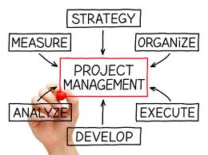
Introduction

Slide 4
What is Project Management?
Project management is the discipline of initiating, planning, executing, controlling, and closing the work of a team to achieve specific goals and meet specific success criteria.
Strive to meet the triple constraint (project scope, time, and cost goals) and also facilitate the entire process to meet the needs and expectations.

Slide 5
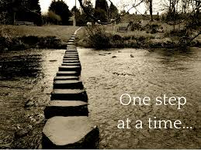
Waterfall Model

Slide 6
Waterfall model
Defined by Dr. Winston Royce in the 1970's
Linear-sequential life cycle model
Involves six stages
Each phase must be completed fully before the next phase can begin
For small projects and there are no uncertain requirements

Slide 7
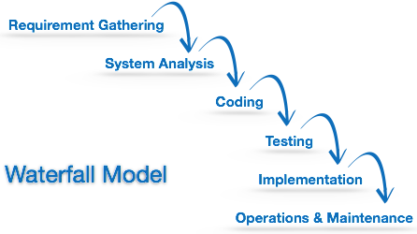
Workflow of Waterfall Model

Slide 8

Pros
Cons
This model is simple and easy to understand and use
It is easy to manage due to the rigidity of the model – each phase has specific deliverables and a review process
In this model phases are processed and completed one at a time. Phases do not overlap
Waterfall model works well for smaller projects where requirements are very well understood
In the testing stage, it is very difficult to go back and change something that was not well-thought out in the concept stage.
High amounts of risk and uncertainty.
Not a good model for complex and object-oriented projects.
Poor model for long and ongoing projects.
Not suitable for the projects where requirements are at a moderate to high risk of changing.

Slide 9
Who prefer Waterfall model?
Companies with functional organization structure
Function does their work before handing it onto the next function
The vast majority of big banks, Telcos and insurance companies work like this

Slide 10
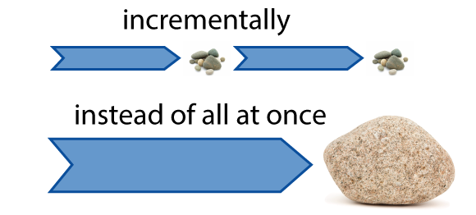
Agile

Slide 11
What is agile?
In English, Agile means ‘ability to move quickly and easily’
– key aspect of Agile software development as well
Agile uses a time boxed, iterative approach
Builds software incrementally from the start of the project
Breaking projects down into little bits called user stories
Prioritizing and continuously delivering them in short cycles called iterations

Slide 12




Agile Manifesto
Established in 2001 by a group of 17 software developers
Individuals and interactions over processes and tools
Working software over comprehensive documentation
Customer collaboration over contract negotiation
Responding to change over following a plan

Slide 13
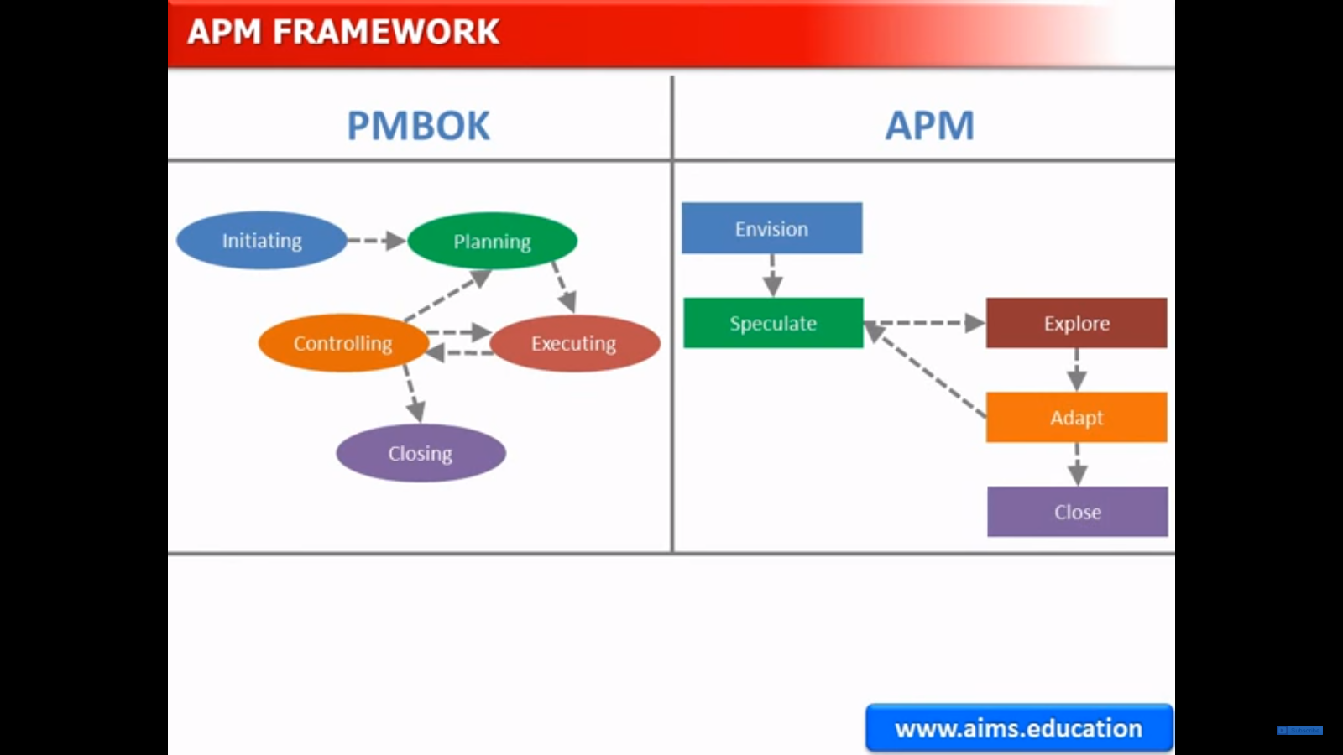

Slide 14
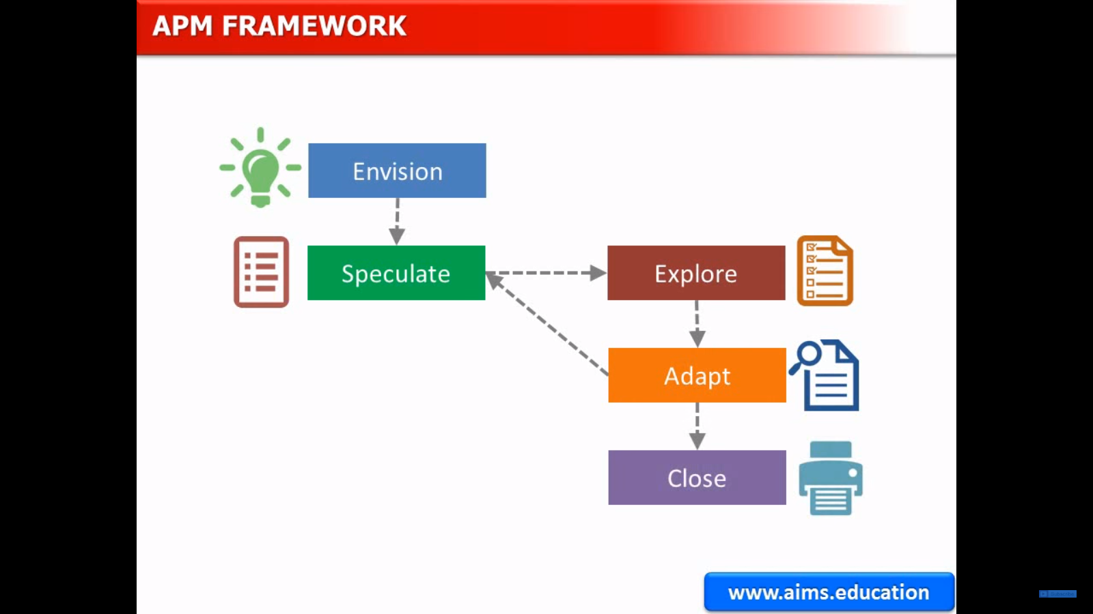

Slide 15
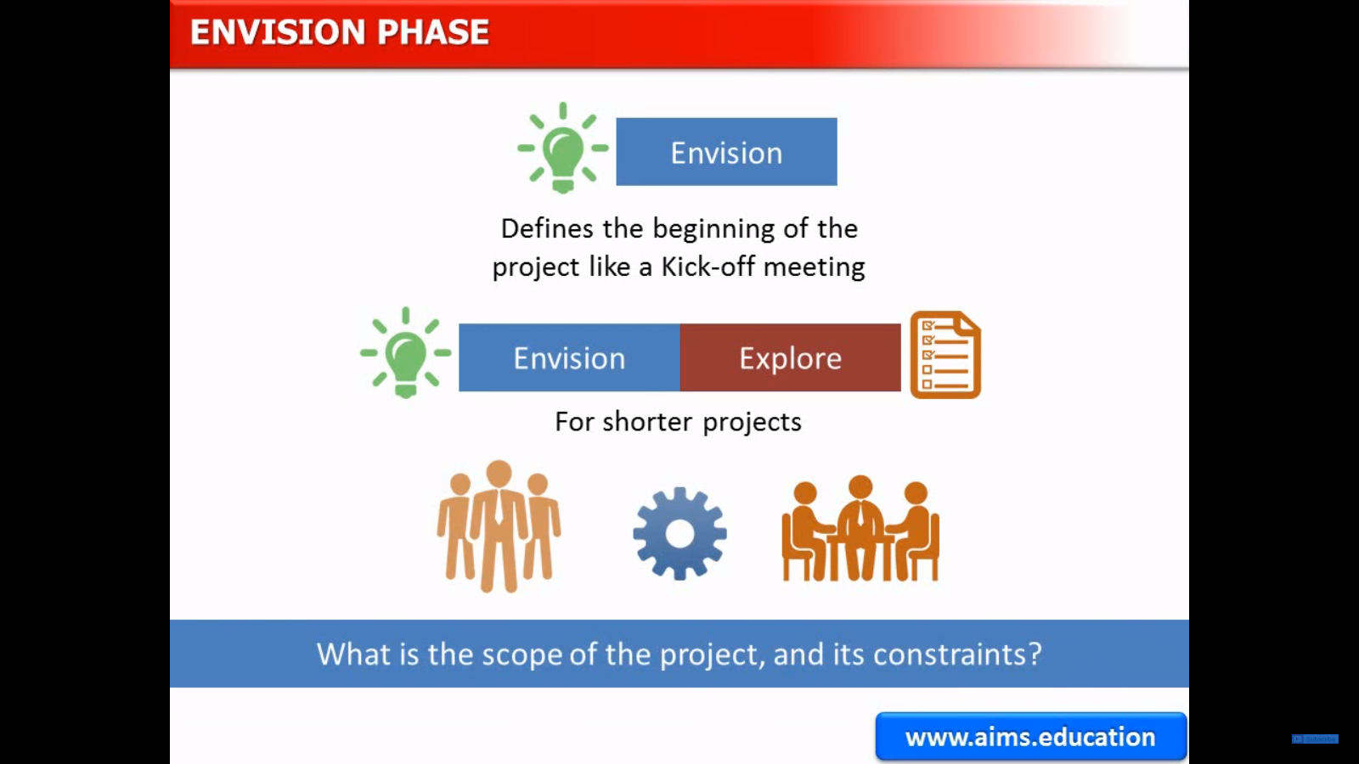

Slide 16
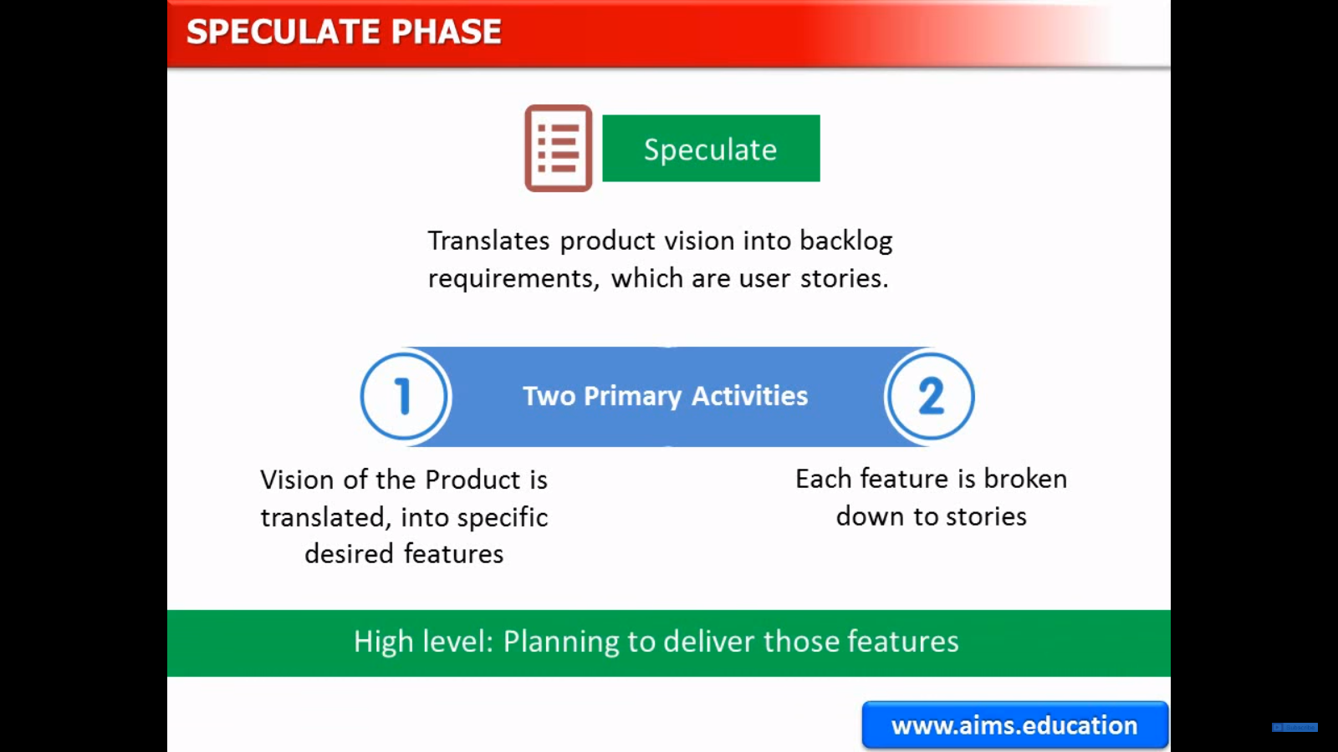

Slide 17
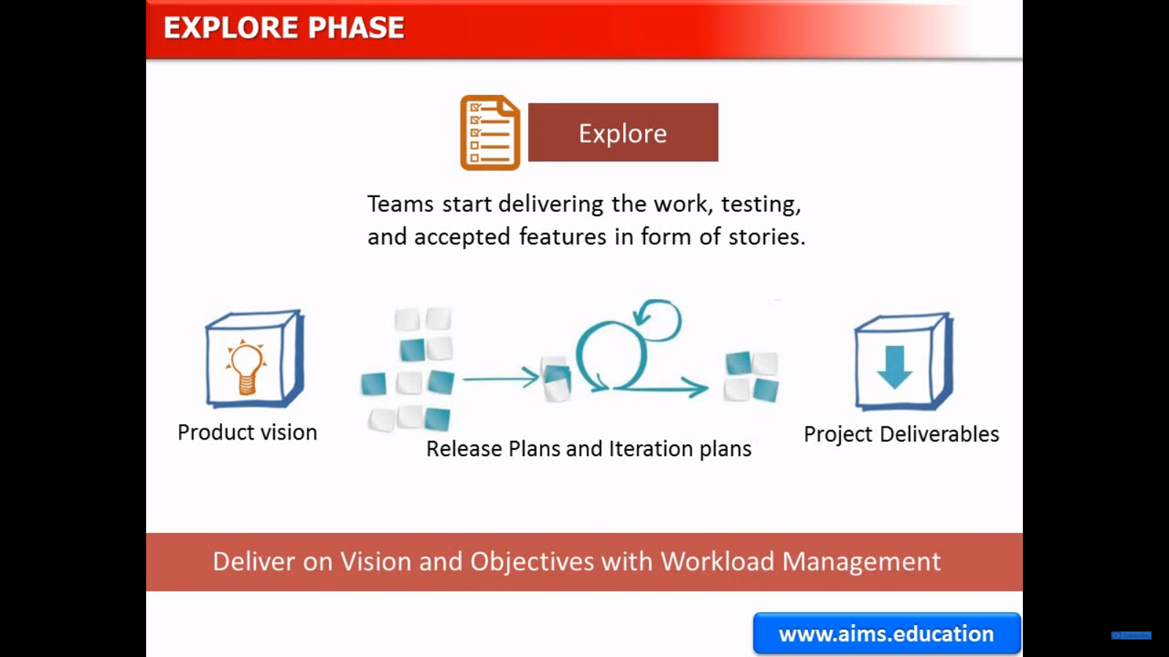

Slide 18
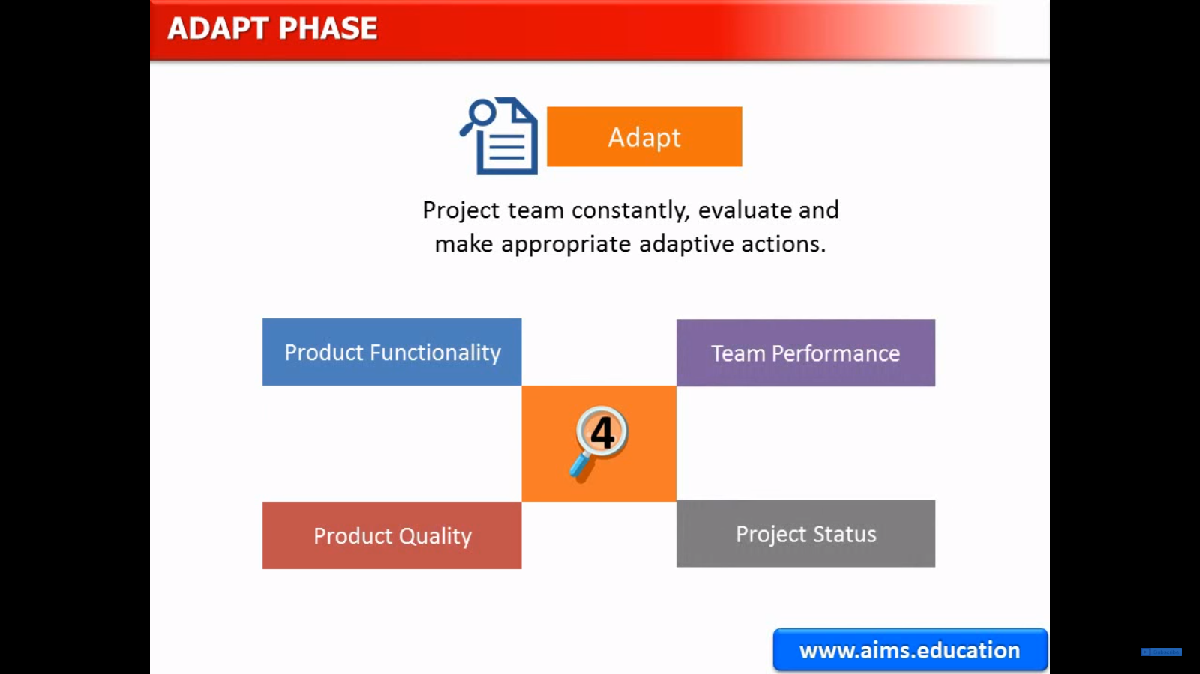

Slide 19
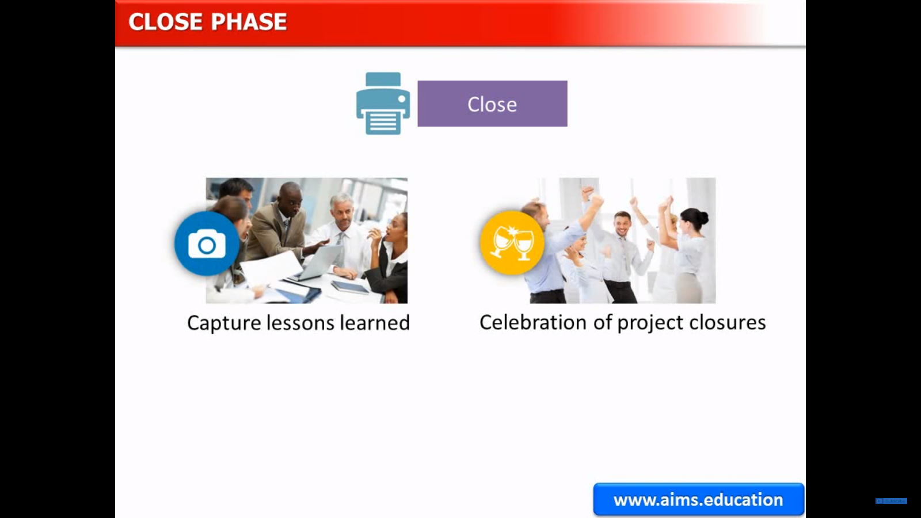

Slide 20
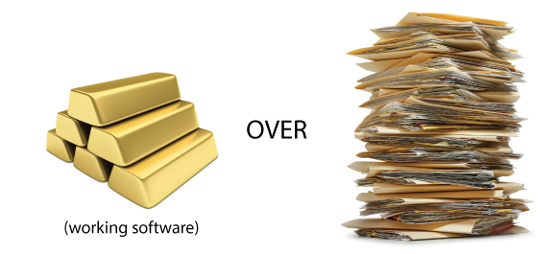
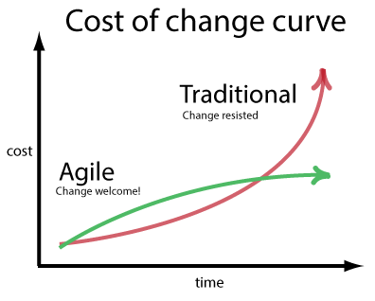
How is Agile different
Requirements can change
Accept and embrace change even late in delivery process
Working software is the primary measure of success
Measures productivity, the rate at which teams can turn their customer's wishes into working software

Slide 21
Pros
Cons
Delivery of software is unremitting.
Customers can have a look of the working feature
Any feedback or any change can be accommodated
Attention to the good design of the product.
Changes in requirements are accepted even in the later stages of the development.
Difficult to predict the expected result as requirement is not very clear
It is difficult to estimate the actual effort required in the starting
May have to face some unknown risks which can affect the development of the project

Slide 22
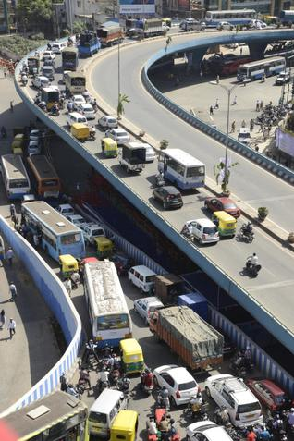
Example
Building a flyover on an extremely busy crossroad in Bangalore, India.
Challenges:
Takes approximately 18 months
Handling high traffic inflow during this time is very difficult

Slide 23
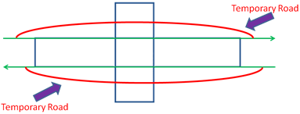
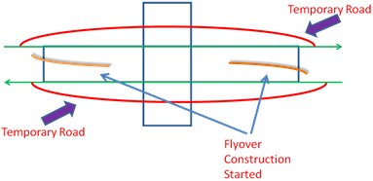
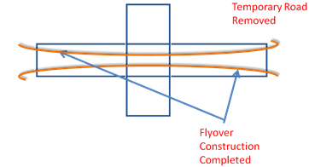
Traditional way of flyover construction
1. A temporary road is constructed next to the main crossroad.
2. Flyover construction work is started from both directions.
3. After 18 months or so, the work is completed and the temporary road is removed.

Slide 24
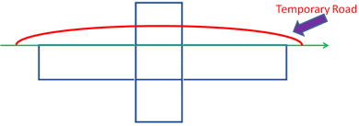
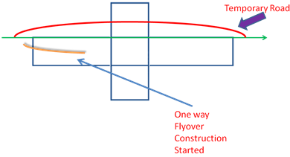
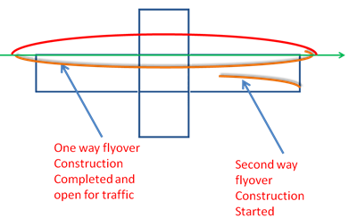
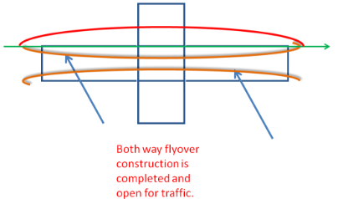
Agile way of flyover construction
1. A one-way temporary road is constructed.
2. A one-way flyover construction is started.
3. The one-way flyover construction is completed and the second-direction flyover construction starts.
4. The second-direction flyover construction finishes.

Slide 25
Benefits
The traffic situation improved at the junction
No need to construct another temporary road
Second-way flyover was constructed without any extreme pressure
The end user got to use the flyover in half the time

Slide 26
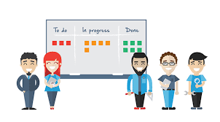
Scrum

Slide 27
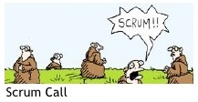
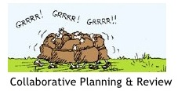
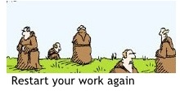
Scrum - an agile process
Agile way of Project Management
A team-based collaborative approach
An iterative and incremental framework
Always focus to deliver Business value

Slide 28
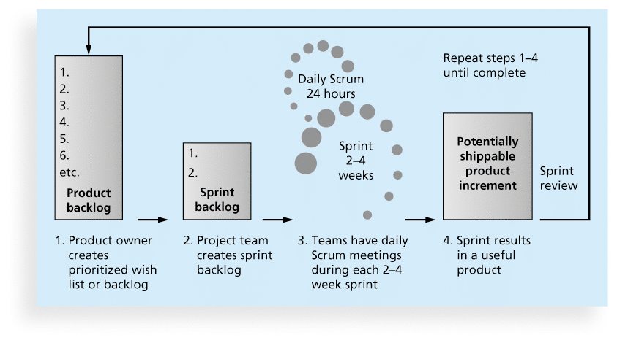
Functionality of Scrum

Slide 29
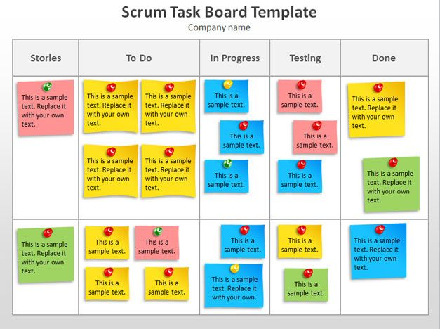
Scrum Task board
Fig 9: Scrum Task Board

Slide 30

Scrum Framework
Roles
Product owner
Scrum Master
Team
Ceremonies
Sprint planning
Sprint review
Sprint retrospective
Daily scrum meeting
Artifacts
Product backlog
Sprint backlog
Burndown charts

Slide 31
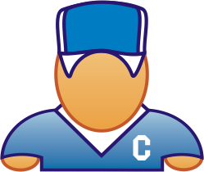






Scrum Master
Like a project manager also called as team facilitator
Facilitates the scrum by removing impediments to the team in reaching their goals. Ensures that scrum process is used as intended
Scrum Team
Product Owner, Scrum Master and Development Team
Development Team
Group of up to 7 people. Perform actual analysis, design, programming, implementation, testing, etc. Teams are self-organizing
Product Owner
Acts like one voice (in any case)
Knows what needs to be build and in what sequence this should be done
Typically a product manager

Slide 32
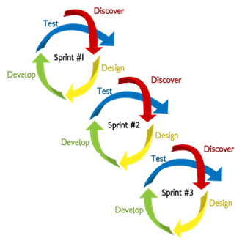
Sprints
Scrum projects make progress in a series of “sprints”
Typical duration is 2–4 weeks or a calendar month at most
Product is designed, coded, and tested during the sprint

Slide 33
Sprint Planning Meeting
Takes 8 hours and consists of 2 parts (“before lunch and after lunch”)
Sprint Review/Demonstration Meeting
1.5 hours (2 weeks sprint) / 3 hours (4 weeks sprint)
Sprint Retrospection Meeting
2 hours (2 weeks sprint) / 4 hours (4 weeks sprint)

Slide 34
Daily Scrum
Is a short (15 minutes long) meeting, which is held every day before the Team starts working
Participants: Scrum Master (which is the chairman), Scrum Team
Every Team member should answer on 3 questions
What did you do since the last Scrum?
What are you doing until the next Scrum?
What is stopping you getting on with the work?

Slide 35
Scrum Artifacts
Product Backlog
Sprint Backlog
Burn down Charts

Slide 36
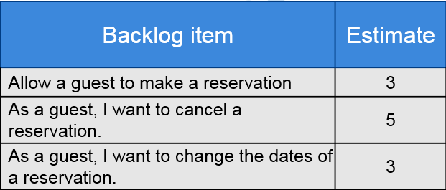
Product Backlog
Requirements for a system, expressed as a prioritized list of Backlog Items
Is managed and owned by a Product Owner
Spreadsheet (typically)
Usually is created during the Sprint Planning Meeting
Can be changed and re-prioritized before each PM

Slide 37
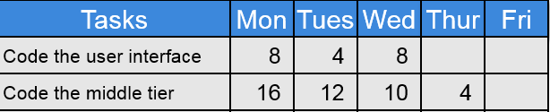
Sprint Backlog
A subset of Product Backlog Items, which define the work for a Sprint
Is created ONLY by Team members
Each Item has it’s own status
Should be updated every day
No more then 300 tasks in the list
If a task requires more than 16 hours, it should be broken down
Team can add or subtract items from the list. Product Owner is not allowed to do it

Slide 38
Burn down Charts
Are used to represent “work done”.
Are wonderful Information Radiators
X-Axis: time (usually in days)
Y-Axis: remaining effort
3 Types:
Sprint Burn down Chart (progress of the Sprint)
Release Burn down Chart (progress of release)
Product Burn down chart (progress of the Product)

Slide 39
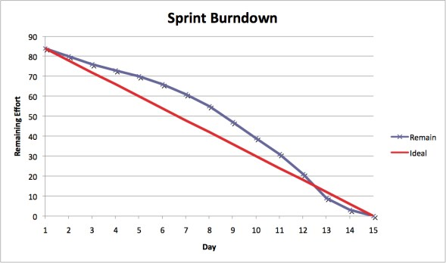
Sprint Burn down Chart
Depicts the total Sprint Backlog hours remaining per day
Shows the estimated amount of time to release
Ideally should burn down to zero to the end of the Sprint
Actually is not a straight line
Can bump UP

Slide 40
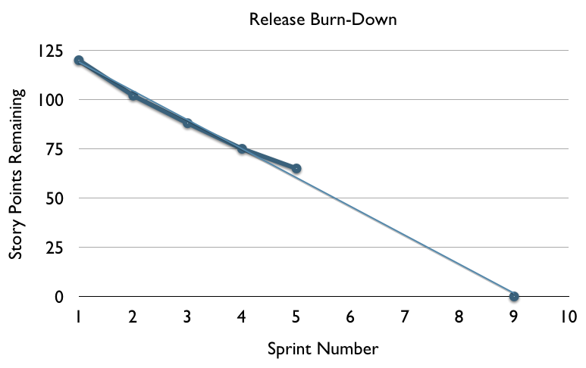
Release Burn down Chart
Will the release be done on right time?
X-axis: sprints
Y-axis: amount of hours remaining
The estimated work remaining can also burn up

Slide 41
Pros Cons
Completely developed and tested features in short iterations
Simplicity of the process
We can measure Individual productivity with Daily Meetings
each team member carries a lot of responsibility
Improved communication
Issues are identified well in advance and can easily resolve them
“Undisciplined hacking” (no written documentation)
Absence of team members commitment leads to failure of project
Agile Scrum is one of the leading causes of scope creep.

Slide 42
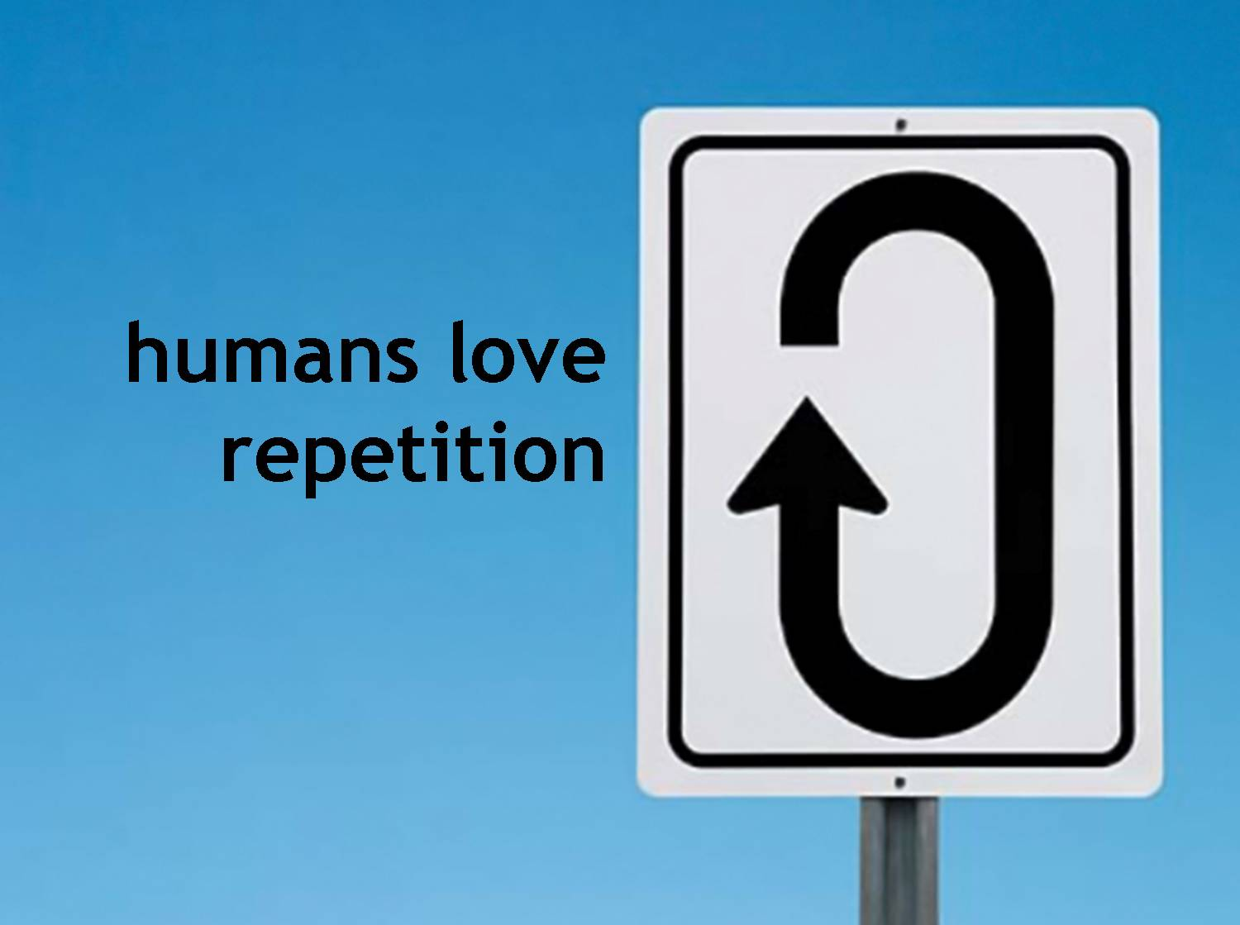
RUP

Slide 43
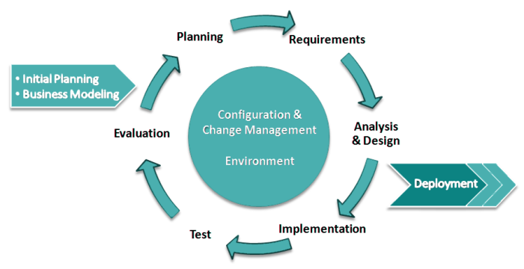
Unified Process
The Unified Software Development Process or Unified Process is a popular iterative and incremental software development process framework.

Slide 44
Unified Process (Contd.)
Use Case Driven
Architecture Centric
Iterative and Incremental
Focus on Risk

Slide 45
Rational Unified Process (RUP)
RUP is a specific implementation of the Unified Process.
Iterative software development process framework created by the Rational Software Corporation, a division of IBM since 2003.
The resulting "Rational Unified Process" (RUP) completed a strategic tripod for Rational:
a tailorable process that guided development
tools that automated the application of that process
services that accelerated adoption of both the process and the tools.

Slide 46

Team-Unifying Approach
The RUP unifies a software team by providing a common view of the development process and a shared vision of a common goal
Increased Team Productivity
knowledge base of all processes
view of how to develop software
modeling language
Rational provides many tools
Tool
Specialist
Architect
Developer
Project
Management
Analyst
Tester
Designer
Notes:
The RUP offers:
A Team-Unifying Approach
The Rational Unified Process unifies the entire software development team and enhances team communication by providing each team member with one knowledge base, one modeling language and one view of how to develop software.
Everybody is involved; their roles and activities are well documented and are publishable over an intranet…
Re-iterate the HHGTTG and the Tower of Babel...

Slide 47
Phases (Contd.)
Define the scope of project
Inception
Elaboration
Construction
Transition

Slide 48
Phases (Contd.)
Inception
Elaboration
Construction
Transition
Plan project, specify features, baseline architecture

Slide 49
Phases (Contd.)
Build the product
Inception
Elaboration
Construction
Transition

Slide 50
Phases (Contd.)
Inception
Elaboration
Construction
Transition
Transition the product into end user community

Slide 51
time
Phases
Process Workflows
Inception
Elaboration
Construction
Transition
Business Modeling
content
Requirements
Analysis & Design
Implementation
Test
Deployment
Supporting Workflows
Configuration & Change Mgmt
Project Management
Environment
Preliminary Iteration(s)
Iter. #1
Iter. #2
Iter. #n
Iter. #n+1
Iter. #n+2
Iter. #m
Iter. #m+1
Iterations
Notes:
Inception Defines the scope of the project. A business plan is often created to determine whether resources should be committed or not. The model is 20% complete.
Elaboration Plan project, specify features, baseline architecture. Requirements are firmed up, we’re now 80% complete. A detailed cost/resource estimation can be drawn up.
Construction Build the product. Several iterations.
Transition Move the product into and end user environment. Training, installation and support.
An iteration is a distinct sequence of activities based on an established plan and evaluation criteria, resulting in an executable release (internal or external)
A workflow shows all the activities you might go through to produce a particular set of artifacts – more later.

Slide 52
Inception Artifacts
Vision: The project's core requirements, key features, and main constraints are documented. Stakeholders …
Glossary: defines important terms used by the project.
Business Case: provides the necessary information from a business standpoint to determine whether or not this project is worth investing in.
Software Development Plan: all information required to manage the project. (Risk, time and durations, needed tools, changes, documentations)
Use-case model: a model of the system's intended functions and its environment, and serves as a contract between the customer and the developers.

Slide 53
Elaboration Artifacts
Software Architecture Document: provides a comprehensive architectural overview of the system, using a number of different architectural views to depict different aspects of the system.
Prototypes: One or more executable architectural prototypes have been created to explore critical functionality and architecturally significant scenarios.
Design model: an object model describing the realization of use cases, and serves as an abstraction of the implementation model and its source code.
Data model: a subset of the implementation model which describes the logical and physical representation of persistent data in the system.
Testing Mechanisms and refining previous Iteration’s artifacts.

Slide 54
Construction Artifacts
The System: The executable system itself, ready to begin "beta" testing
Training materials: the material that is used in training programs or courses to assist the end-users with product use, operation and/or maintenance
Testing results and refining previous Iteration’s artifacts

Slide 55
Transition Artifacts
Product
Release Notes: identify changes and known bugs in a version of a build or deployment unit that has been made available for use
Installation Artifacts: refer to the software and documented instructions required to install the product
End-User Support Material: Materials that assist the end-user in learning, using, operating and maintaining the product
Testing results and refining previous Iteration’s artifacts

Slide 56
Best Practices
Modelling Data Visually
Verify Quality
Control Changes
Manage Requirements
Break down into Components
Notes:
Six best practices[edit]
Six best practices as described in the rational unified process is a paradigm in software engineering that lists six ideas to follow when designing any software project to minimize faults and increase productivity. These practices are:^{[9][10]}
Develop iterativelyIt is best to know all requirements in advance; however, often this is not the case. Several software development processes exist that deal with providing solution on how to minimize cost in terms of development phases.
Manage requirementsAlways keep in mind the requirements set by users.
Use componentsBreaking down an advanced project is not only suggested but in fact unavoidable. This promotes ability to test individual components before they are integrated into a larger system. Also, code reuse is a big plus and can be accomplished more easily through the use of object-oriented programming.Model visuallyUse diagrams to represent all major components, users, and their interaction.
"UML", short for Unified Modeling Language, is one tool that can be used to make this task more feasible.
Verify qualityAlways make testing a major part of the project at any point of time. Testing becomes heavier as the project progresses but should be a constant factor in any software product creation.
Control changesMany projects are created by many teams, sometimes in various locations, different platforms may be used, etc. As a result, it is essential to make sure that changes made to a system are synchronized and verified constantly.

Slide 57
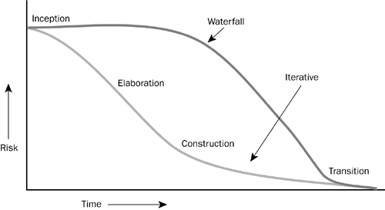
Risk Profile of an Iterative Development

Slide 58
Pros Cons
Emphasis on accurate documentation
It is proactively able to resolve the project risks associated with the client's evolving requirements
Less time is required for integration
The development time required is less due to reuse of components.
The team members need to be expert
The development process is too complex and disorganized.
The reuse of components will not be possible for new technologies.
But Integration on particularly big projects with multiple development streams will only add to the confusion and cause more issues during the stages of testing

Slide 59

Group Discussion

Slide 60
Conclusion
Waterfall model
Is used only when the requirements are very well known, clear and fixed
When ample resources with required expertise are available freely
When technology is understood
Agile model
Is beneficial in a competitive market with changing user requirements as you will be able to make changes fast.
RUP model
Is helpful if you're producing a packaged consumer software product, with new versions that need to be leaps ahead of previous versions

Slide 61


